Slide 1
Adequate Housing And A Responsive-to-Challenges Environment
Republic of Iraq
Ministry of Planning
Executive Management of The Poverty Reduction Policies
24th COMCEC Poverty Alleviation Working Group

Slide 2
Introduction
Housing is one of the challenges facing the government in poverty reduction. A number of housing projects have been implemented in most governorates, with 1,988 housing units distributed in the governorates of Muthanna, Wasit, Diwaniyah, Kirkuk, and Anbar. Work is underway to implement a number of additional complexes, totaling 3,000 housing units.
Applications are submitted through an electronic form, which includes several questions, the answers are converted into points. Based on these points, applicants are evaluated electronically, and housing units are distributed free of charge to those in need.
We would also like to point out that the questions refer to the poorest groups, which are the disabled, families of martyrs, residents of informal settlements, those affected by displacement as a result of military operations, those with limited income, and those below the poverty line. The comparison is based on family size, the educational attainment of the household head, and other indicators that are updated semi-annually in a manner consistent with and designed to improve targeting of the poor.

Slide 3
The Problem
The poor suffer from environmental problems in which they live, including poor housing quality, overcrowding, pollution, and inadequate infrastructure. Poor housing reflects and contributes to the deprivation they experience.
The Goal
Providing a suitable housing environment for the poor.

Slide 4
Activities
Implementing affordable housing projects in poor areas.
Rehabilitating informal settlements.

Slide 5
Implementing affordable housing projects in poor areas.

Slide 6
2. Rehabilitating informal settlements.

Slide 7
Challenges
The lack of prior land allocation and the presence of encroachments in some locations have delayed the implementation of a large number of projects.
The lack of approved standard models for economic roles has led to variance in specifications and costs, obstructing listing and implementation procedures.
The varying implementation costs among implementing agencies have affected the balance in project submissions.

Slide 8
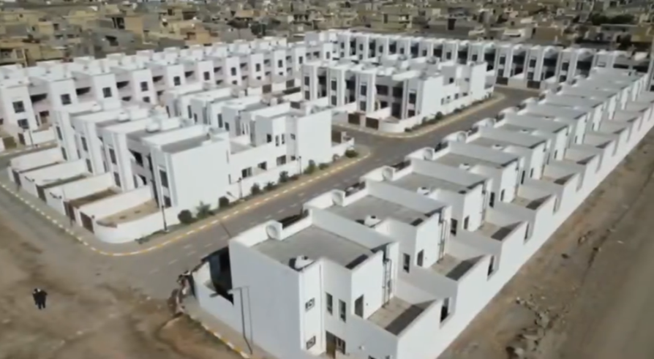
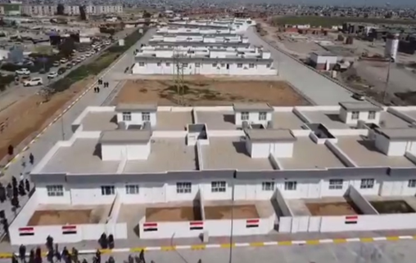
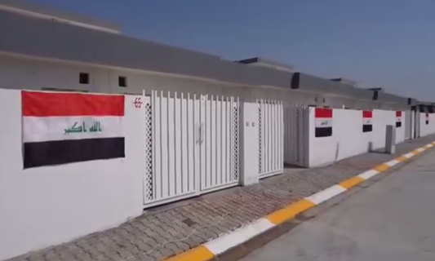
Samples of residential units

Slide 9
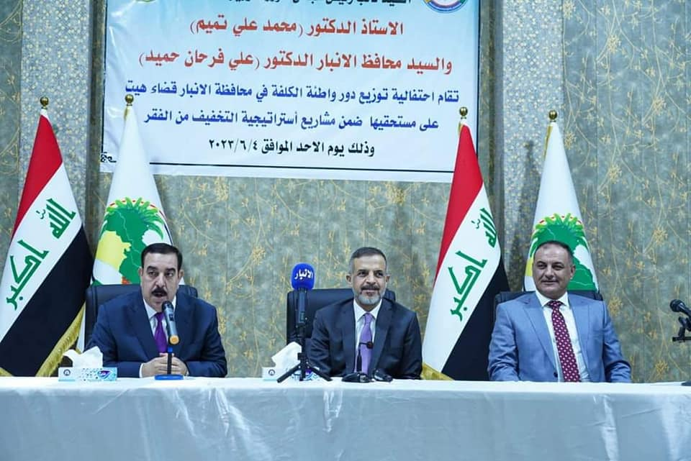
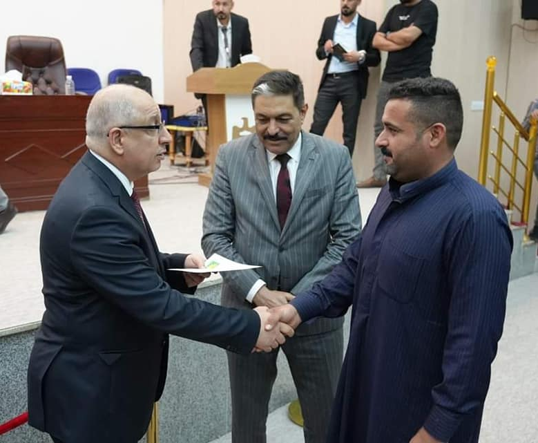
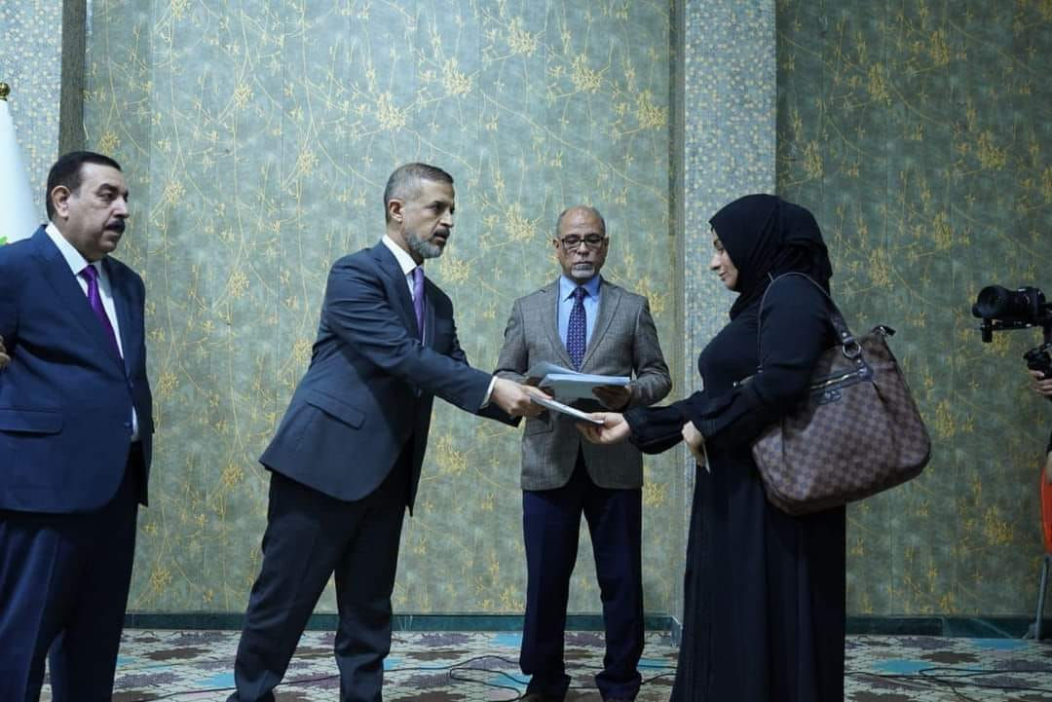
Part of the distribution of houses

Slide 10
Thank you for listening.
Finally, we reaffirm our commitment to implement housing projects for the poor as a fundamental part of the poverty reduction strategy, focusing on creating adequate housing and a responsive-to-challenges environment, working as part of the government's poverty reduction project in cooperation with other ministries and departments, looking forward to exchanging expertise with member states and strengthening international cooperation.

