Slide 1
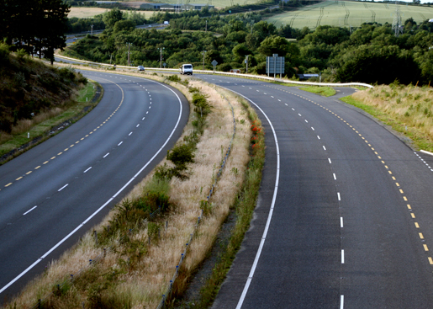
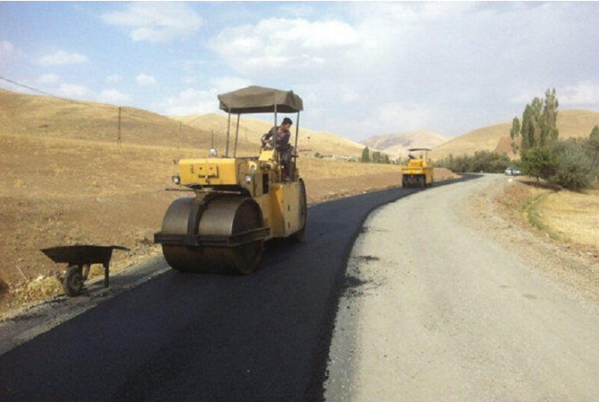
Islamic Republic of Iran Ministry of Roads & Urban Development
The Measures Taken by the I.R.Iran
on Developing the Rural Roads
24th Transport & Communication Working Group Session of the COMCEC
24 April 2025
Presented by:
Mehran Khamisizadeh, Phd
Deputy Chairman of the International Affairs Center

Slide 2
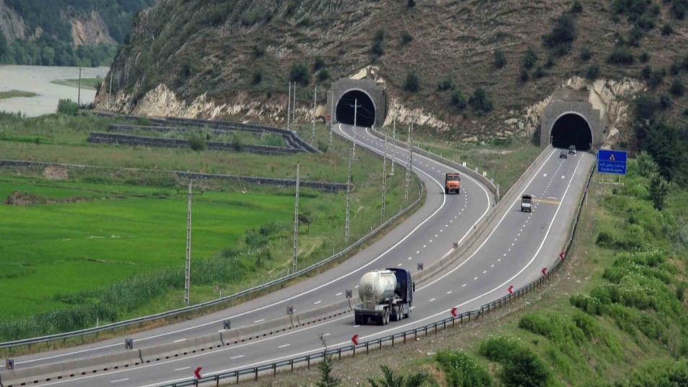
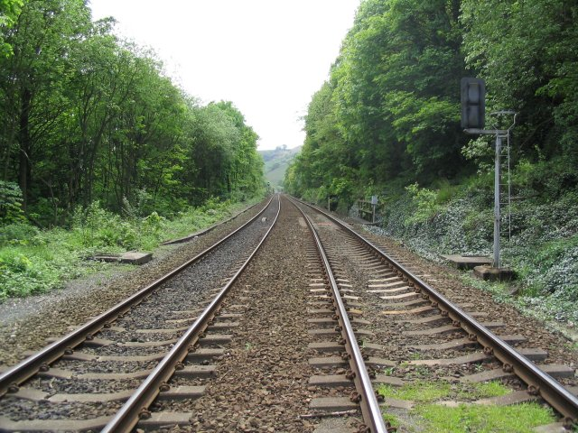
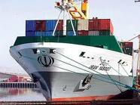
Overview to the Transport Infrastructure Development
15,000 km. Railway Network
More than 250,000 km. All kinds of Roads (Highways, Freeways, Main Roads, Rural Roads, etc)
16 Commercial Sea Ports situated in the North and South of the country
More than 167 Customs Houses situated throughout the country
More than 54 Commercial Airports

Slide 3
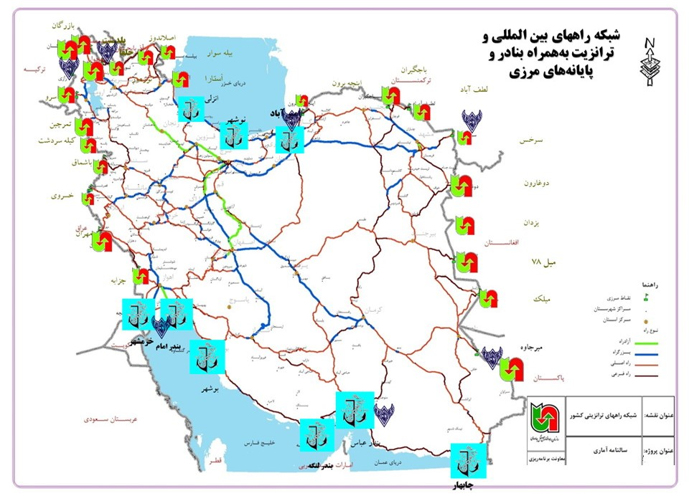
Road Network of the I.R.IRAN
The total Roadway network of the country is about 250/000 Km
The total kilometers of national roads which are under the umbrella of the ministry of Roads and Urban Development is classified as the following:
3053 km Freeway
21086 km Highway
26012 km Major Road
37601 km Minor Road
116000 km Rural Road( Asphalted)
37000 km Other Roads (including non- asphalted rural roads)
---------------------------------------------

Slide 4
The Map of the Road Network of the I.R.IRAN
Caspian Sea
Persian Gulf

Slide 5
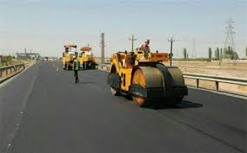
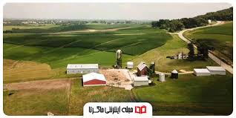
Basic Facts on developing the Rural Areas
Fundamentally , construction of the transportation roads is one of the criteria of developing
There are several definition for the rural roads including;
preliminary definition; connecting the villages together
Formal definition; connecting the rural production centers to each other and connecting them to the main and minor roads network of the country
Industrialization of the rural areas
Emphasizing on rural industry, SMEs, Small industrial towns in the rural areas
Providing the incentives for industrialization of the rural areas and making the balance between rural areas and the cities

Slide 6
Classification of the Rural Roads in Iran
According to the instruction of the planning and Budget Organization the Rural Roads categorized in 3 classes;
Rural Roads Grade 1; This kind of roads connects the production centers of the villages to each other as well as to the main and minor roads network. The average of the heavy vehicles which anticipates passes through this roads in a 5 years period is less than 80 vehicles and more than 30 vehicles per day.
Rural Roads Grade 2;This kind of roads connects the villages production centers to the affiliated villages. The average of the heavy vehicles which anticipates passes through this roads in a 5 years period is less than 50 vehicles and more than 20 vehicles per day.
Rural Roads Grade 3;This kind of roads connects the less population villages to the high population villages. The average of the vehicles which anticipates passes during a 5 years period is less than 20 vehicles per day.

Slide 7
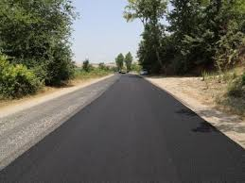
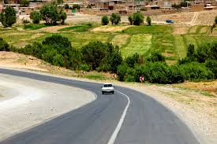
Technical Specifications of the Rural Roads in Iran
The most important Technical Specifications of the Rural Roads in all 3 classes categorized are as follow;
Avoiding of the construction of the bridges in most cases( in case of necessity utilization of the typical bridge and using of the concrete pipes and water features in the rural roads )
Construction of the Parking in both wings of the rural roads in appropriate spots ( the distance of the parking to another is 1 Km, with the length of 25 meter and width 3 meter)

Slide 8
The Main Plans for Developing the Rural Roads
Up-dating the data centers
To Provide developing & completing plans
More accessibility to the social services centers
Mobilization &Utilization of the sources of the people partnerships

Slide 9
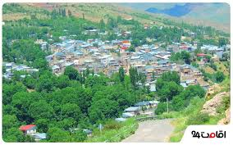
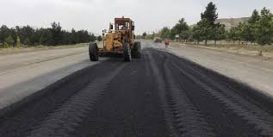
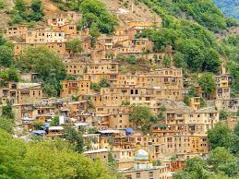
Construction Priorities of the Rural Roads in Iran
Basically the road infrastructures network in particular in rural areas, is one of the criteria which justify the mechanisms for bringing the investment in these areas.
One of the priorities is the villages with more than 100 families (households), which consists of 810 villages in the country. The length of the rural roads in these villages is very outstanding.
In a 8 years periods, 5000 km of the rural roads must be re-asphalted annually, due to heavy congestions of transportation and increasing the utilization of these roads.
Moreover, paving the rural roads by asphalt for the villages with 20 famillis (households), envisaged in the developing plans of the country.

Slide 10
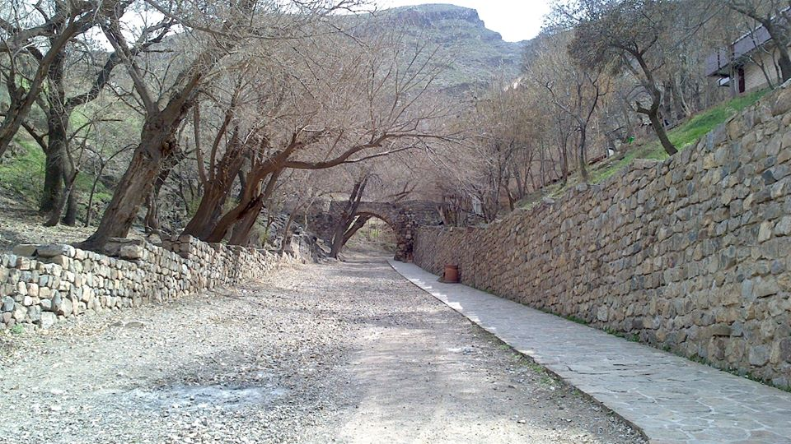
Construction and Maintenance of the Rural Roads
Construction and Development of the Rural Roads ( Villages more than 20 Families (households) ), 3000 km
Maintenance and paving Asphalt of the Rural Roads,3000 km
Maintenance and paving Asphalt of the Minor Roads, 3000 km

Slide 11
The Most Measures taken in developing the Rural Roads
Revising the criteria of the possess and poverty in the villages with over 20 families(households) and providing the new criteria by planning and budget organization
Considering the re-distribution of the credits to the unti- poverty projects
Follow- up the implementation of the rural roads in the provinces of the country
Follow – up the plans of the sea coasts development
Mobilization of the financial resources of the some non- profit organizations/ institutions in paving the Asphalt of the rural roads
Mobilization and utilization of the capacities of charity funds in construction, re-habilitations of the rural roads

Slide 12
Project analysis slide 10
The Main Challenges of the Rural Roads
Decreasing the Budget (Public resources and budget of the provinces)
Decreasing the quality of the Asphalts
Increasing the level of destroy
Increasing the costs of the materials
Increasing the volume of demands

Slide 13
The operational plans for construction and maintenance of the Rural Roads in the Country
Providing the Asphalt for the villages with more than 20 family
The number of the villages with 20 families (households), which possess asphalt roads
33154
The number of the villages with 20 families (households), without asphalt roads
6311
The total of the villages with 20 families (households), and more
39465
Percentages of the possessed villages with more than 20 families (households), based on the criteria of the number of possessed villages
%83/9
Percentages of the possessed villages with more than 20 families (households)of the asphalted roads, based on the criteria of the number of possessed families (households)
%92/8

Slide 14
THANK YOU FOR YOUR KIND ATTENTION

