Slide 1
24th MEETING OF THE COMCEC TRADE WORKING GROUP
By Hakkı Karataş, PhD
Chief Economist at DEIK
April 21, 2025 Istanbul

Slide 2
Outline
1- BRIEF INFO ABOUT DEIK
2- TRADE OUTLOOK WITH ISLAMIC COUNTRIES and DEIK STRATEGIES

Slide 3
1
DEIK

Slide 5
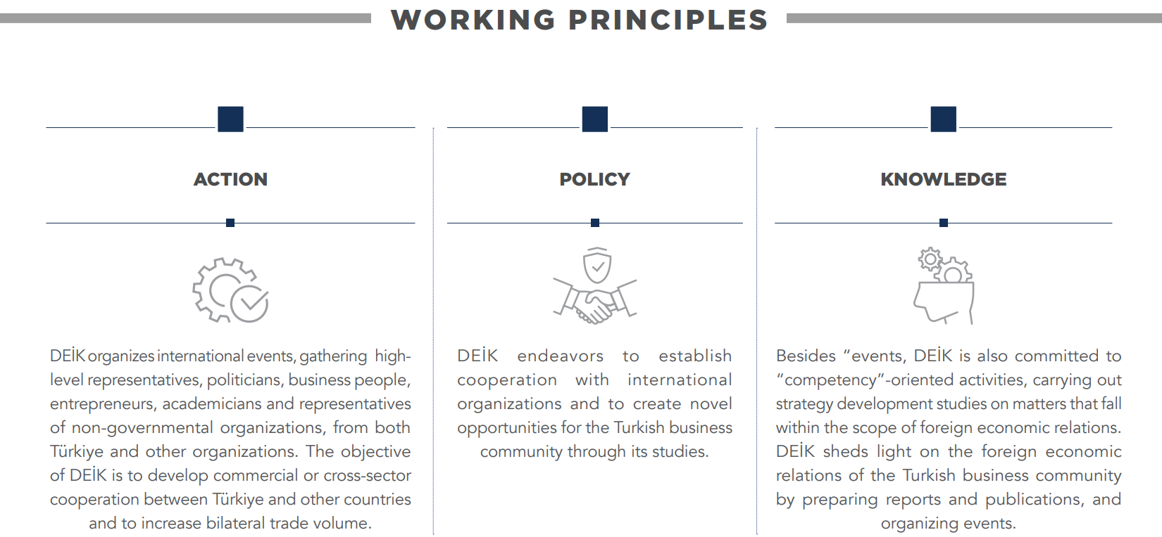

Slide 6
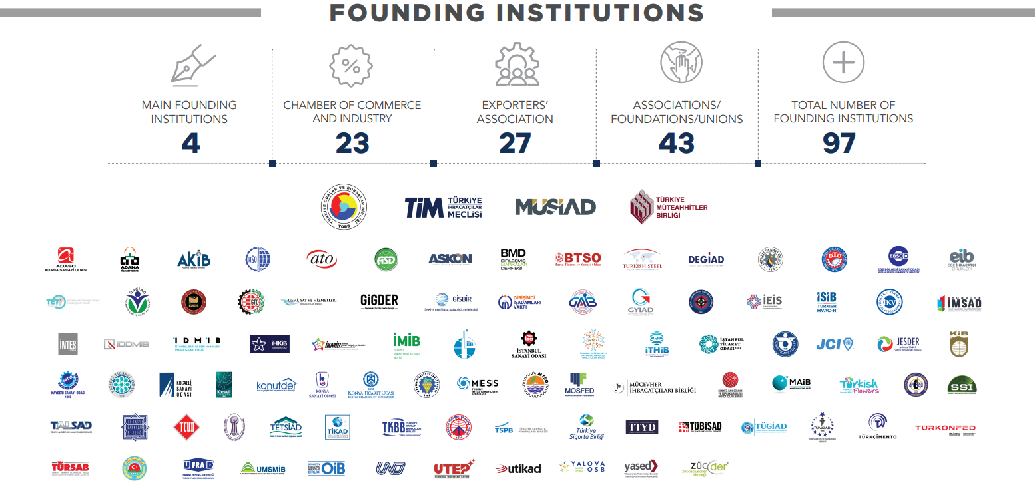

Slide 7
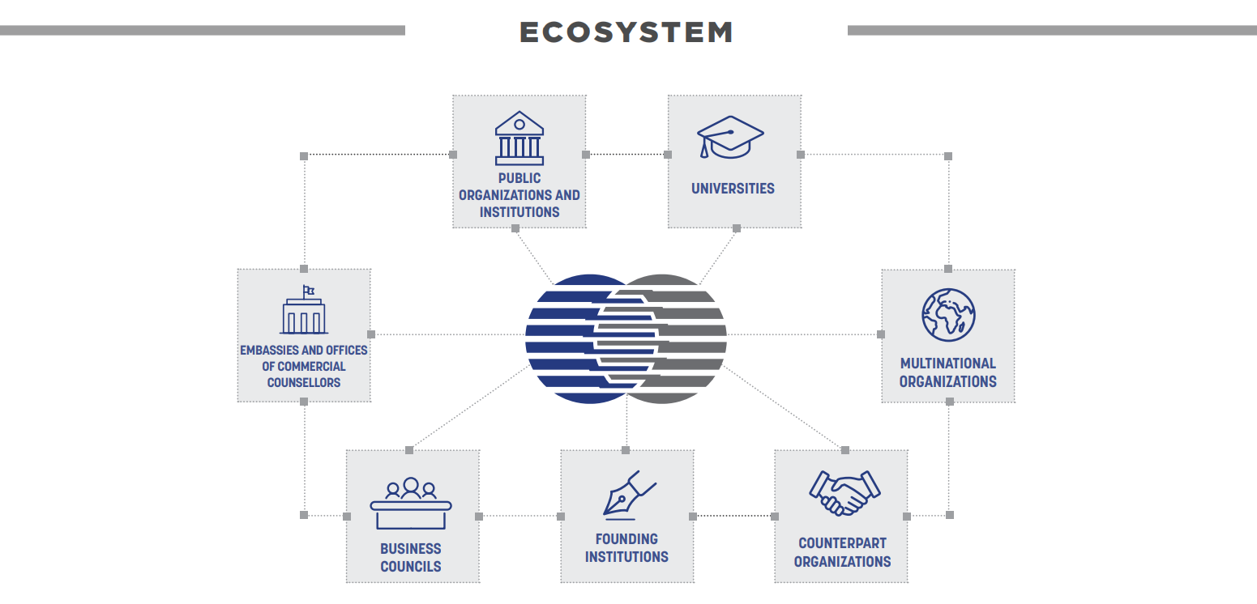

Slide 11
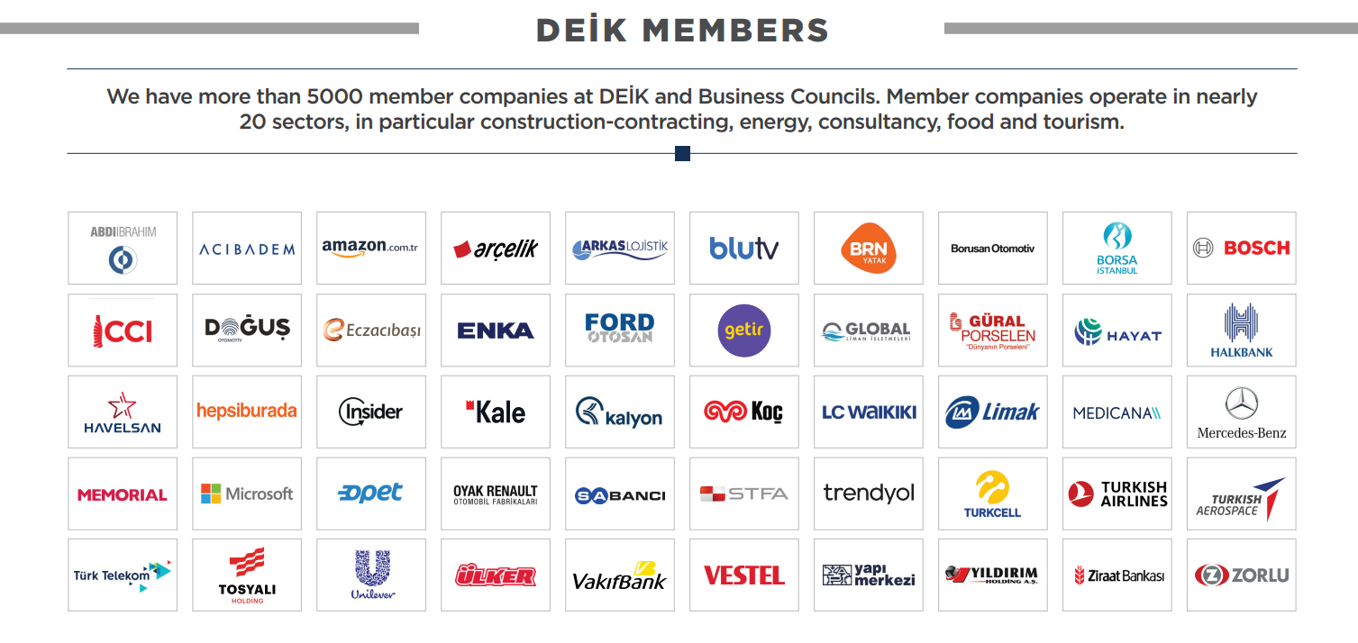

Slide 12
2
Trade Outlook with Islamic Economic Cooperation Countries

Slide 13
Trade Outlook of Turkiye with OIC Countries (2013-2024
Billion USD | 2024 | 2023 | 2022 | 2021 | 2020 | 2019 | 2018 | 2017 | 2016 | 2015 | 2014 | 2013
Exports to OIC Countries | 70 | 66 | 64 | 57 | 44 | 49 | 45 | 49 | 44 | 47 | 54 | 54
Imports from OIC Countries | 43 | 45 | 40 | 31 | 31 | 26 | 30 | 33 | 24 | 23 | 31 | 33
Trade Volume | 113 | 111 | 105 | 87 | 75 | 75 | 75 | 81 | 68 | 70 | 84 | 88
Billion USD | 2024 | 2023 | 2022 | 2021 | 2020 | 2019 | 2018 | 2017 | 2016 | 2015 | 2014 | 2013
Total Exports of Türkiye | 262 | 256 | 254 | 225 | 170 | 181 | 177 | 164 | 149 | 151 | 167 | 161
Total Imports of Türkiye | 344 | 362 | 364 | 271 | 220 | 210 | 231 | 239 | 202 | 214 | 251 | 261
Total Trade Volume Of Turkisye | 606 | 618 | 618 | 497 | 389 | 391 | 408 | 403 | 351 | 365 | 418 | 422
% | 2024 | 2023 | 2022 | 2021 | 2020 | 2019 | 2018 | 2017 | 2016 | 2015 | 2014 | 2013
Share of OIC Countries in our Exprts | 26.7 | 25.8 | 25.3 | 25.2 | 25.8 | 27.0 | 25.3 | 29.6 | 29.7 | 30.9 | 32.3 | 33.6
Share of OIC Countries in our imports | 12.4 | 12.4 | 11.1 | 11.3 | 14.1 | 12.5 | 12.9 | 13.7 | 11.8 | 10.9 | 12.2 | 12.8
Share of OIC countries in total trade volume | 18.6 | 18.0 | 16.9 | 17.6 | 19.2 | 19.2 | 18.3 | 20.2 | 19.4 | 19.2 | 20.2 | 20.7

Slide 14
DEIK’s strategies to increase our trade relations with OIC Countries:
1- Increase mutual investments: Hep middle east and Gulf countries to diversify their economies
2- Mutual trade: Increase our business diplomacy efforts with OIC countries
3- Grand GCC Forum: This is a new forum that will bring all stakeholders together. We will organize this every 2 years starting with next year
4- Increase mutual collaboration in Islamic finance
5- Helal certificate: Mutual acceptance of Helal Certificates

Slide 15
Thank you very much for your attention for further questions
hkaratas@deik.org.tr

