Slide 1
THE REPUBLIC OF TÜRKİYE MINISTRY OF AGRICULTURE AND FORESTRY
22.04.2025

Slide 2
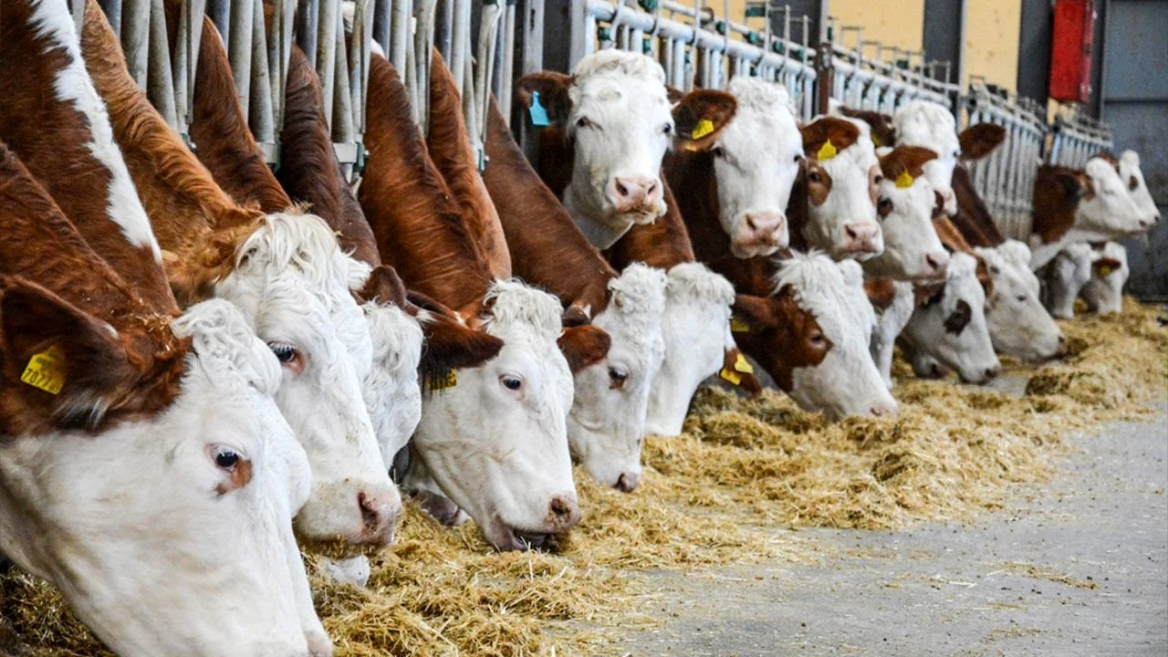
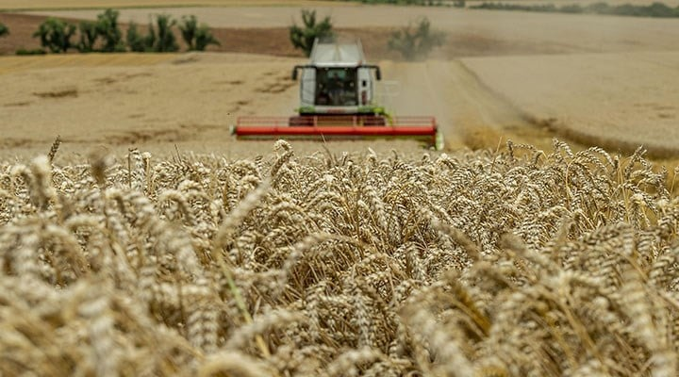
Türkiye has a wide range of experience in agricultural and rural development activities and supports spanning many years.
There are a wide range of supports carried out with national and international resources.

Slide 3
Agricultural Support Programs
Plant Production
Animal Production
Aquaculture Production
Rural Development
Agricultural Research And Development
Total Agricultural support budget for 2025 is 135 billion TL

Slide 4
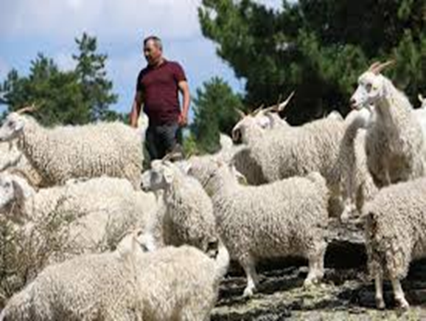
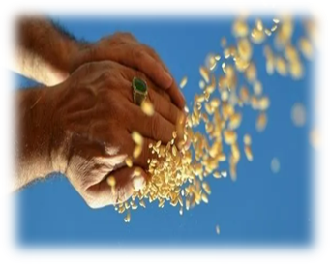
1- Plant Production: Basic support, planned production support, production development supports, biological and biotechnical control support, licensed warehousing support etc.
2- Animal Production: Cattle farming support, small livestock supports, raw milk, cattle fattening support, beekeeping support etc.
Notes:
Üretimi geliştirme destekleri: sertifikalı tohum, fidan kullanım, organik tarım, iyi tarım, katı organik gübre

Slide 5
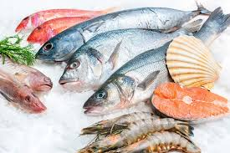
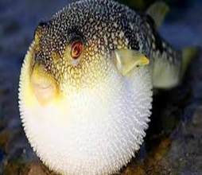
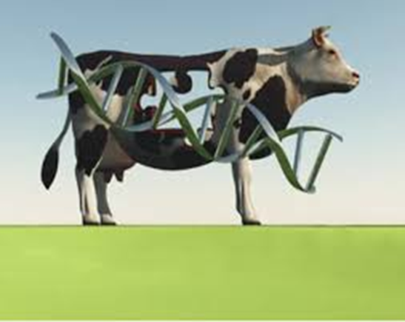
3- Aquaculture Production: Aquaculture support, small-scale fisheries support, pufferfish fishing support
4- Agricultural Research and Development: Animal genetic resources support, Agricultural R&D projects.
5- Rural Development:
Notes:
Üretimi geliştirme destekleri: sertifikalı tohum, fidan kullanım, organik tarım, iyi tarım, katı organik gübre

Slide 6
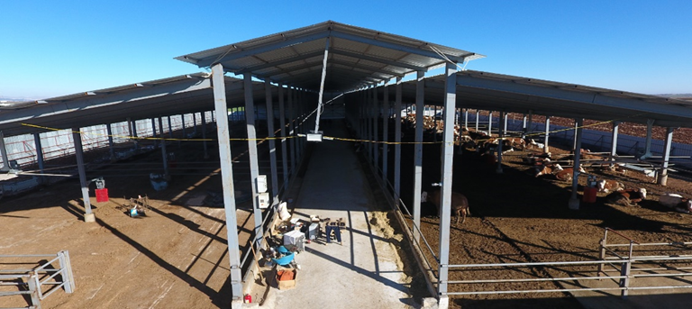
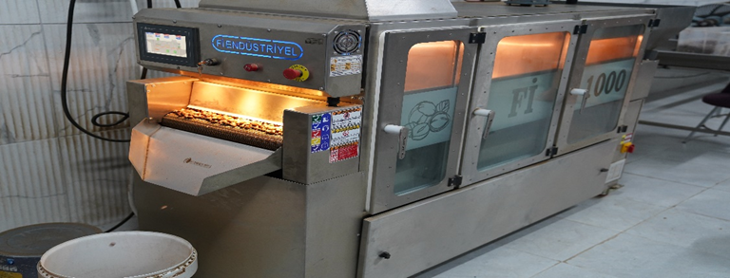
Rural Development Supports
KKYDP/ IPARD/ International Funded Projects( Disadvantaged areas )/ Irrigation

Slide 7
The basic grant rates for investment measures,
KKYDP 50 % ( 100.000 TL - 20.000.000 TL)
IPARD start at 50% and can go up to 75%. ( 20.000 Euro – 3.000.000 Euro)
International Funded Projects in disadvantaged areas ( IFAD/ World Bank) ( %70-%100)
Irrigation 50% ( up to 10.000.000 TL)
Positive discrimination is applied to,
women
young people
producer groups
Environment
Vulnerable groups

Slide 8
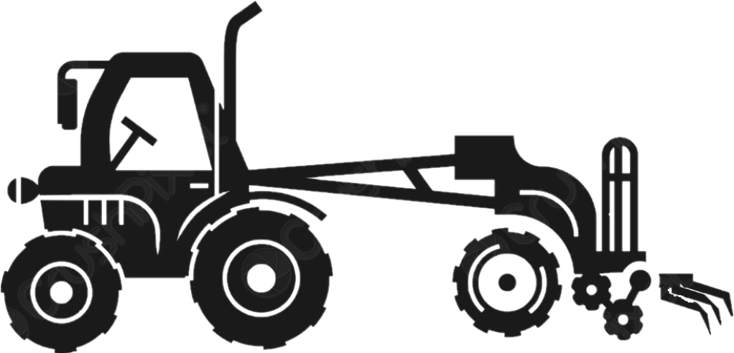
Rural Development Investments Support Program (KKYDP)
Economic and Infrastructure Investment Projects
Machinery Equipment Supports
19.781 Project
60 Billion TL Grant
125.183 Employment
299.320
Machinery
22 Billion TL Grant
Between 2006-2025
Economic and Infrastructure Investment Projects
2025
411 Project
945 Million TL Grant
794 Employment

Slide 9
Investment Topics of KKYDP | Number of Projects
Infrastructure Systems Investments for the Development of Family Business Activities | 4.513
Investments on Beekeeping and Bee Products Processing and Packaging | 121
Investments on Information Systems and Education | 215
Steel Silo (Storage of Agricultural Products) | 685
Improving Farming Operations | 3.490
Investments for Handicrafts and Value Added Products | 30
Processing, Drying, Packaging and Storage of Animal and Plant Origin Fertilizers | 70
Investments for Rural Tourism | 53
Investments for Machinery Park | 8
Cold Storage | 493
Investments for Structuring of Aquaculture | 42
Fixed Investments for Agricultural Production | 2.250
Processing, Drying, Freezing, Packaging and Storage of Agricultural Products | 6.266
Investments for Collective Pressurized Irrigation | 630
Investments for the Use of Renewable Energy Resources | 708
Renewable Energy Production Facilities | 207
TOTAL | 19.781

Slide 10
Expert Hands Project
To those whom have received high school equivalent or higher education in the agricultural field,
For their projects for rural areas
100% grant is given up to 250 thousand TL
Project Topics;
a) Projects for animal production.
b) Projects for plant production.
c) Projects for aquaculture production (provided that the maximum production capacity does not exceed 29 tons/year).
ç) Projects for the production of geographically indicated products and traditional products.
d) Projects for the processing, packaging and storage of the products specified in clauses (a), (b), (c) and (ç).

Slide 11
In summary
Economic and Infrastructure Investment Project
Machinery Equipment Support
Expert Hands
For Licensed Warehouses and Producers
2006-2025
2006-2025
2020-2025
2015-2025
Lisanslı Depoculuk
19.781 Project
60 BillionTL Grant
125.183 Employment
299.320
Machine
22 Billion TL Grant
2.413
Project
930 Million TL Grant
224.681 Warehouse/Producer
4 Billion TL Grant

Slide 12
IPARD Programme
IPARD is the Rural Development component of the Instrument for Pre-Accession Assistance established by the European Union to support candidate countries.
IPARD aims; to support harmonization preparations and policy development for the implementation and management of the Common Agricultural Policy, Rural Development Policy and related policies of the European Union.
With the grants provided under the programme, it is aimed to promote compliance with EU standards in food safety, animal health, plant health and environment and to contribute to the sustainable development of rural areas.

Slide 13
The IPARD Program started to be implemented in Türkiye in 2011 and a total of two programs were completed until the end of 2024.
In the IPARD I and II period;
25,612 projects were supported.
1.86 Billion Euros in Grant Payments were made.
96,257 people were employed.
The IPARD III Program covering the period 2021-2027 was actually started to be implemented in 2024.

Slide 14
Measures Implemented under the IPARD Program
M1- Investments in Physical Assets of Agricultural Holdings
M3- Investments in Physical Assets Concerning Processing and Marketing of Agricultural and Fishery Products.
M4- Agri-Environment, Climate and Organic Farming Measure,
M5- Implementation of Local Development Strategies – LEADER Approach
M7- Farm Diversification and Business Development.
M9- Technical Assistance.

Slide 15
International Funded Projects Applied in Disadvantages Areas TÜRKİYE’S
IFAD AND WORLD BANK PROJECTS APPROACH

Slide 16
ONGOING PROJECTS
GÖKSU TAŞELİ WATERSHED DEVELOPMENT PROJECT
2017-2025
$ 22.27 M
UPLANDS RURAL DEVELOPMENT PROGRAMME 2018-2027
$ 73.49 M
TÜRKİYE RESILIENT LANDSCAPE INTEGRATION
2021-2027
The Total Budget of the Project: 111.8 Million Euro
The Project Budget of the Directorate General of Agrarian Reform (DGAR) :17.9 Million Euro

Slide 17
Some Examples of Support Schemes:
Beekeeping Equipment and Hives
Sewerage Systems with Biological Treatment
Shepherd Shelters
Support for the Very Poor and Poor Households
Apple Slicing Machine
Solar Power Plant
Animal Welfare and Health Center
Establishment of Cherry Orchard
Portable Barn/Pen
Installation of Vegetable Greenhouse
Rooftop Solar Power Plant on Cold Storage
High-Trellis Vineyard Installation
Honey Filling and Packaging & Fondant Sugar Production Facility
Individual Irrigation
Solar Energy Panels
Walnut Peeling Machine
On-Farm Drying
Establishment of Strawberry Orchard
Electric Fence
Solar-Powered Irrigation System
Göksu Taşeli Watershed Development Project GTWDP
Project is being implemented in Konya
Karaman provinces
Beneficiary | Support % | Investment Amount (Euro)
Individual | 70% | 15.000
Young and Women | 80% | 17.142
Farmer Organization | 80% | 250.000
Small and Medium Enterprises | 70% | 218.750
Vulnerable Groups | 100% | 5.000

Slide 18
Some Examples of Support Schemes:
Demonstration Installation of Strawberry and Plum Orchards
Livestock Drinking Water Tank
Lamb and Sheep Tent
Machinery and Equipment Grant Support
Establishment of Chickpea Field
Construction of Water Troughs
Living Tent and Honey Extractor for Beekeepers
Walnut Orchard Demonstration
Establishment of Walnut Orchard
Demonstration of Home-Type Drying System (Persimmon)
Construction of Shade Structures
Installation of Closed Irrigation Water Systems
Establishment of Kiwi and Lavender Orchards
Support for Modern Beehives
Greenhouse Installation
Milk Cooling Tank
Tent with Portable Solar System (for Nomadic Families)
Living Container
Feed Mixing Machine
Construction of New Tent Barn
Uplands Rural Development Programme (URDP)
Project is being implemented in Adana, Mersin, Osmaniye, Bartın, Kastamonu, Sinop, Çankırı and Kahramanmaraş Provinces
Beneficiary | Support % | Investment Amount (Euro)
Individual | 70% | 22.000
Young and Women | 80% | 22.000
Farmer Organization | 75% | 333.333
Earthquake Package | 100% | 22.000
Vulnerable Groups | 100% | 5.000
Yörüks | 100% | 15.000

Slide 19
Türkiye Resilient Landscape Integration Project
(TULIP)
Some Examples of Support Schemes:
Efforts to Combat Bee Diseases
Establishment of Kiwi Orchard
Small Ruminant Livestock Development Project
Procurement of Machinery and Equipment
Cattle Breeding Development Project
Pasture/Highland Improvement and Management Works
Milking Machine
Seed Distribution
Project is being implemented in in two separate basins, the Bolaman Stream Basin Rehabilitation Project (Ordu, Tokat)
and the Çekerek River Basin Rehabilitation Project (Çorum, Sivas, Tokat, Yozgat)
Beneficiary | Support %
Individual Grants | 70%
Demonstrations | 100%

Slide 20
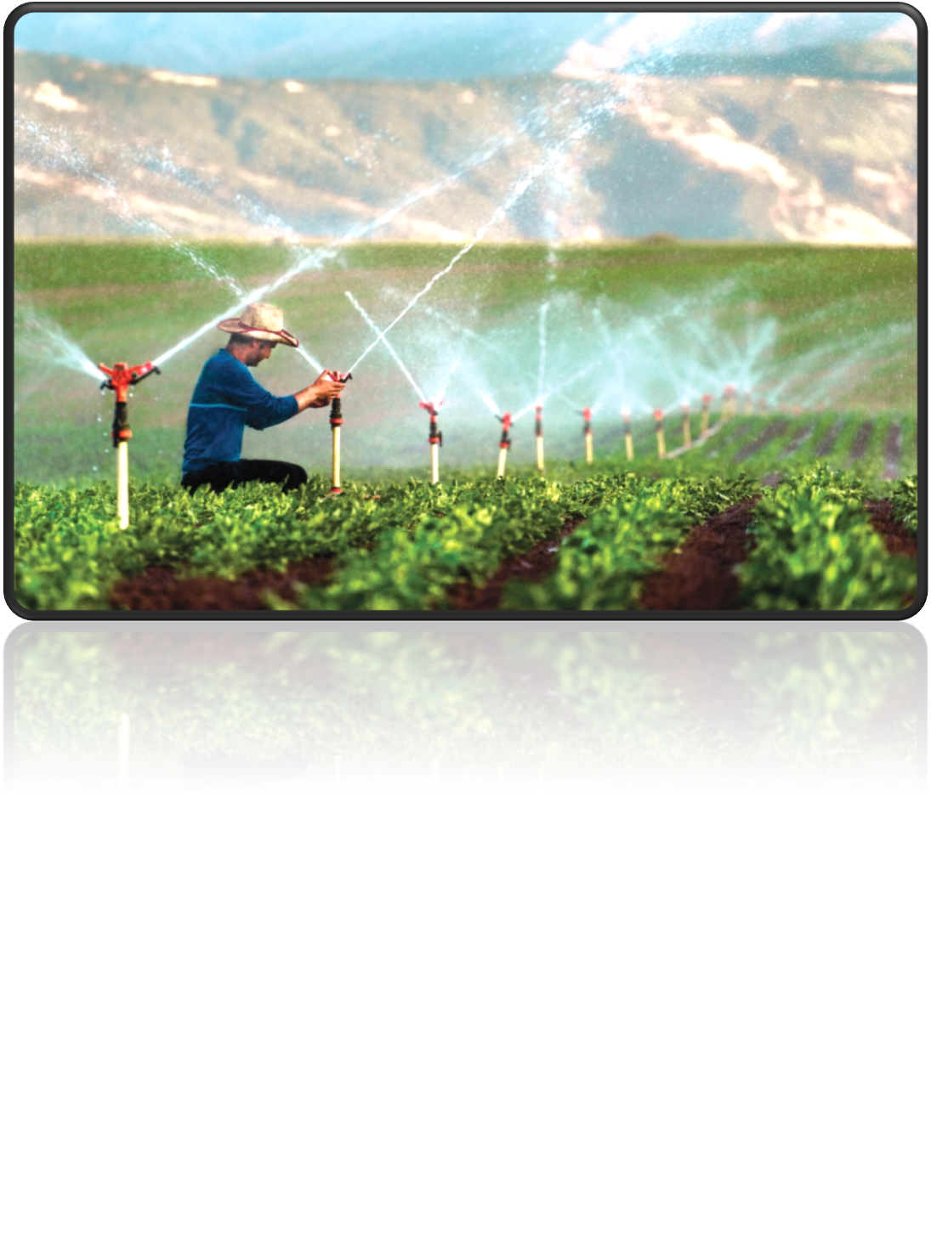
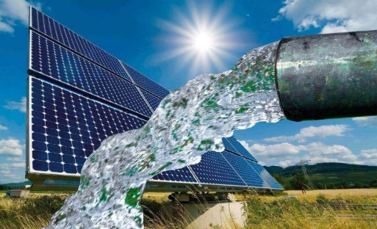
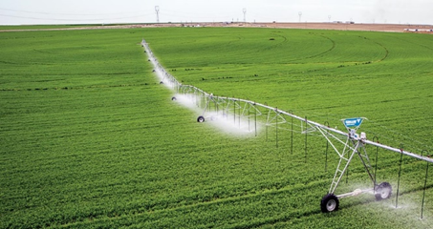
IRRIGATION
Summary of Work Conducted; To conduct and support studies on the dissemination of modern on-farm pressurized irrigation systems that will save water.

Slide 21
Modern pressurized irrigation systems that provide water savings in agriculture have been given a 50% grant support since 2007.
As of the end of 2007/2024, the basis for the grant is;
Number of projects (number): 57296
Area (million acres): 5.4
Grant payment (Billion TL): 10,5
As of 2025, the project upper limit has been increased from 3 million TL to 10 million TL

Slide 22
Investment issues within the scope of support
In-field drip irrigation system
In-field sprinkler irrigation system
In-field micro sprinkler irrigation system
In-field subsurface drip irrigation system
Linear or Center Pivot irrigation system
Drum irrigation system
Solar-powered irrigation system
Smart irrigation system

Slide 23
KIND REGARDS

