Slide 1
The Role of IsDB in Promoting Islamic Financial Instruments to Combat Climate Change and Natural Disasters in Member Countries
THE 23RD MEETING OF THE COMCEC FINANCIAL COOPERATION WORKING GROUP
Climate Change & Environment Division
Presenter: Habib Abubakar, Senior Climate Change Specialist
22 April, 2025

Slide 2
Presentation content
Context & challenges of oic Member countries on climate action
Highlights of IsDB Climate Ambition Commitments to MC
Climate Change at the IsDB – Main Pillars
Making IsDB Operations Climate Resilient
Climate action support to mc through project-level intervention.
Opportunities for Climate Action using Islamic Financial Instruments
Examples of Financial Resources (Grants) Leveraged for Member Countries from IsDB Partners

Slide 3
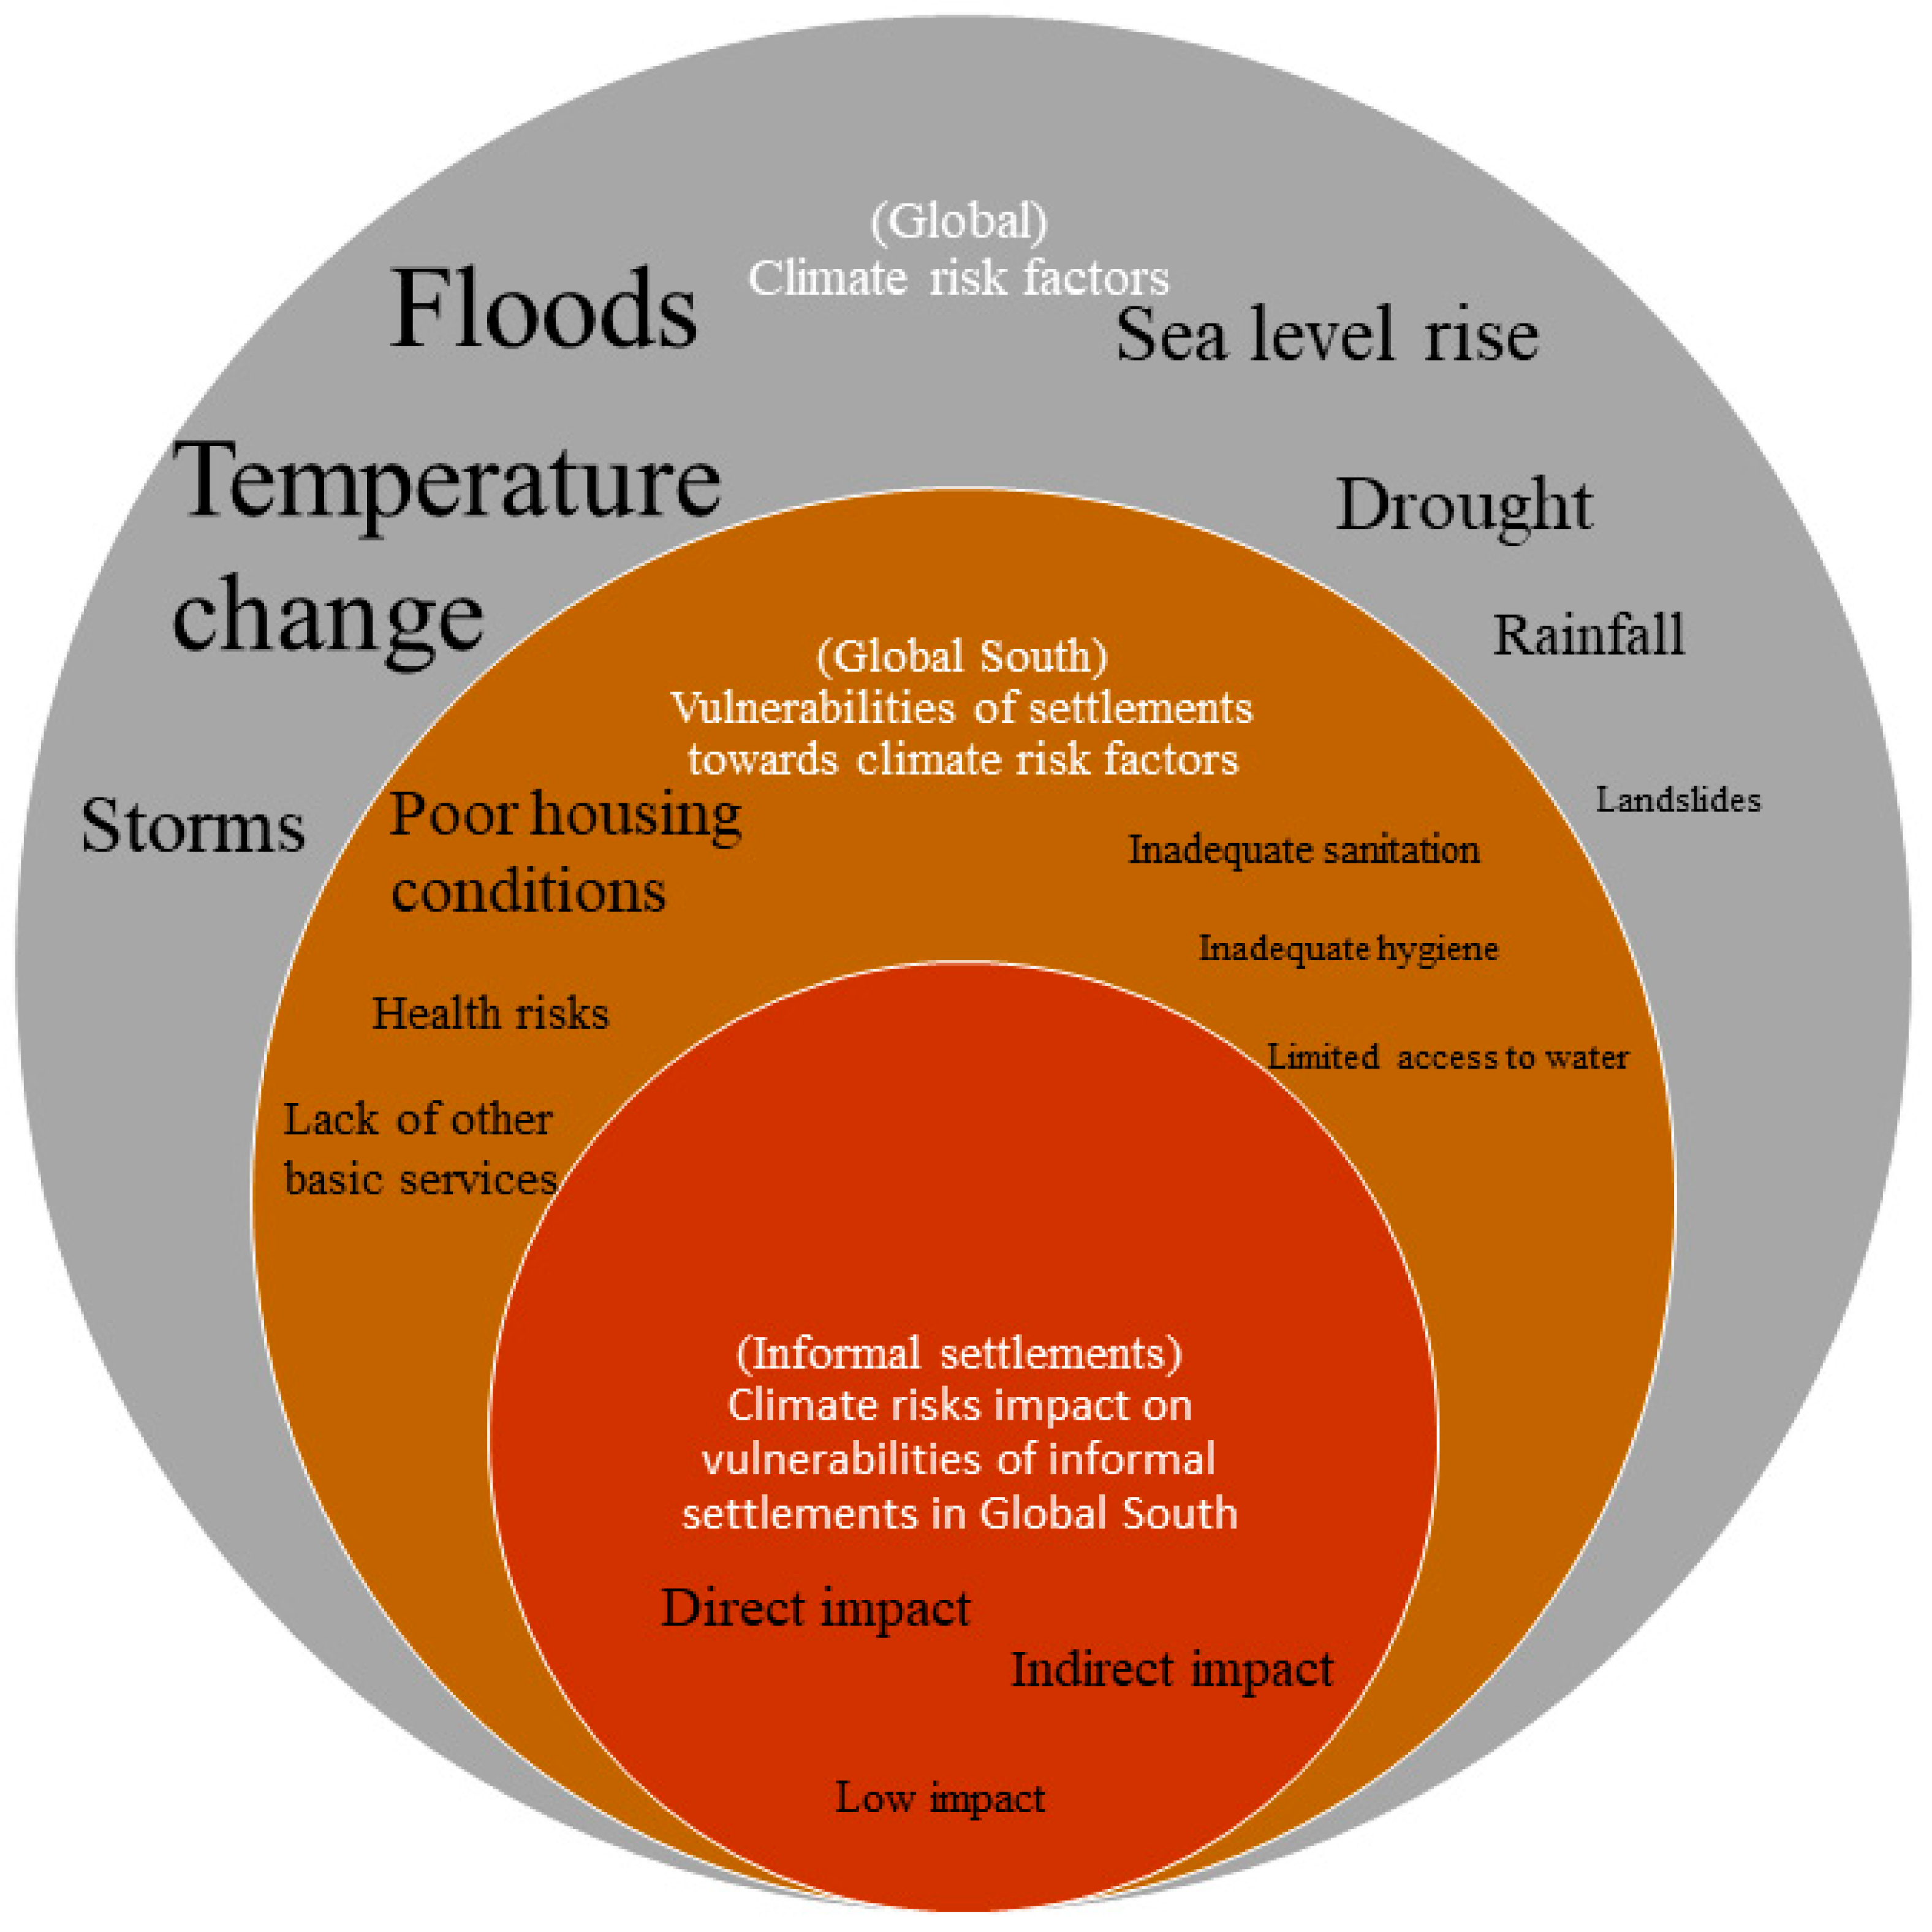
Context & challenges of oic Member countries on climate action
OIC countries are among the most vulnerable to climate-related risks. This includes increasing frequency of floods, droughts, and food insecurity
Limited access to climate finance and climate resilience infrastructure: Disaster Risk monitoring and Economic Strain
Gaps in climate governance frameworks and data systems: hamper the planning and implementation of adaptation and mitigation policies. Limited inter-agency coordination

Slide 4
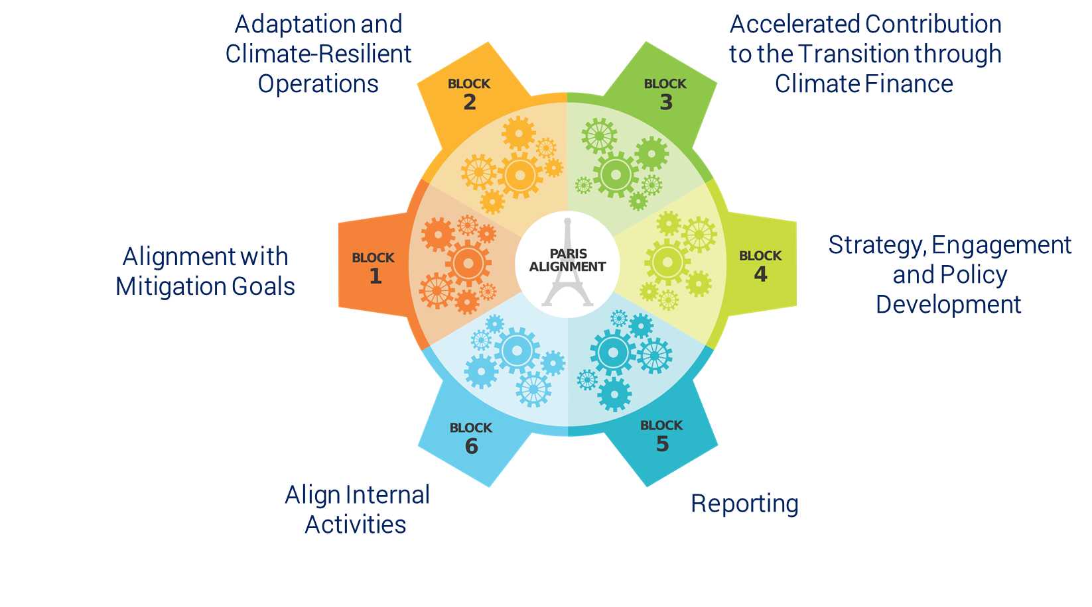
Highlights of IsDB Climate Ambition Commitments to MC
100% Paris Alignment Commitment by 2023
US$ 24 billion Arab Coordination Group (ACG) Climate Finance by 2030
35% Climate Finance Target of total Commitment by 2025

Slide 5
Climate Change at the IsDB – Main Pillars
4
3
2
Climate Financing and Leveraging
1
Capacity Building and Knowledge Generation in MCs
Mapping of Climate Funds and Donors
Green Bonds and Markets: What do we need?
Strategies for Sequencing Public and Private Investments, PPPs and other Strategies to catalyze private investment
Support MCs Paris Agreement Realization
Resilience Workshops
Sector Focused CC Workshops
Climate Risk and Disaster Management Frameworks
Knowledge Reports (Guidance Reports, etc.)
Policy Advisory
Risk Management Strategies
Creating Enabling Environment
Mainstreaming in Operations
Development of National Action Plans (NAPs)
Development of Nationally appropriate Mitigation Actions (NAMAs).
Pre-feasibility Analysis
Project Preparation Facility
Integration of CC in Upstream Country Discussions, Strategies, etc. Setting Targets and Tracking.
Operational Support including Appraisal, Design, etc.
Climate Screening Tool
Project Appraisal and Design
Sector Guidance Notes and Best Practices

Slide 6
Climate Risk Management Process: Making IsDB Operations Resilient
Establish adaptation objective.
Identify adaptation options.
Use a multi-criteria approach to appraise adaptation options (e.g., functional effectiveness, technical feasibility, affordability, stakeholder acceptability, etc.).
Conduct economic assessment of shortlisted adaptation options.
Select adaptation strategy.
Stakeholder engagement is critical to these steps.
Preliminary, rapid assessment of the risks posed to a planned project as a result of climate change.
Tools and methodologies used include Acclimatise (Aware); World Bank (Climate and Disaster Risk Screening Tool); International Institute for Sustainable Development (Community-Based Risk Screening Tool Adaptation & Livelihoods (CRiSTAL).
PROJECT IMPACT ASSESSMENT
IMPLEMENTATION
CLIMATE RISK SCREENING
Identify the climatic variables of interest for the project. These may include meteorological (e.g., temperature, precipitation); hydrologic (e.g., runoff volume, groundwater recharge, soil moisture); and other environmental (e.g., sea-level rise) variables. When their impacts are harmful, these variables are referred to as climate hazards.
Identify the changes in environmental conditions (or system impacts) likely to follow from changes in the above variables (e.g., reduced raw water quality, increased evapotranspiration, increased frequency of floods).
Determine the vulnerability of different project components to changes in environmental conditions. Vulnerability is a function of th project’s exposure, sensitivity, and adaptive capacity to a specific climate hazard.
ADAPTATION ASSESSMENT
Establish implementation arrangements for selected adaptation measures (determine roles and responsibilities; identify needs for technical support and capacity building, etc.).
Provide for ongoing monitoring and evaluation.

Slide 7
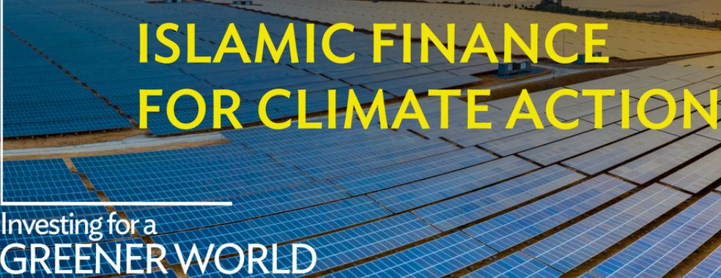
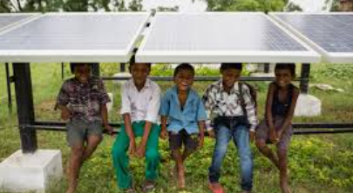
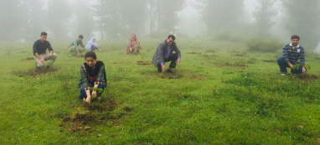
Climate action support to mc through project level intervention
Comoros: US$ 15.00 million to enhance the resilience, connectivity, and safety of maritime transport between the islands of the country - FY2024
Kyrgyzstan: US$ 45.11 million to enhance the livelihoods of smallholder farmers and improve food security through agriculture. FY 2024
Pakistan: US$ 118.40 million, aiming at alleviating poverty among vulnerable communities while simultaneously improving their overall food security, nutritional status, and resilience to climate change. FY 2024
Nigeria: US$ 52.00 million Zamfara Climate Change Adaptation and Agricultural Value Chain Project to improve food security in this vulnerable region of Nigeria, FY 2025
Türkiye, EUR 500.00 Climate & Disaster-Resilient Health Infrastructure Project aims to enhance the provision of safe, sustainable, and disaster-resilient healthcare services that can withstand earthquakes. FY 2025

Slide 8
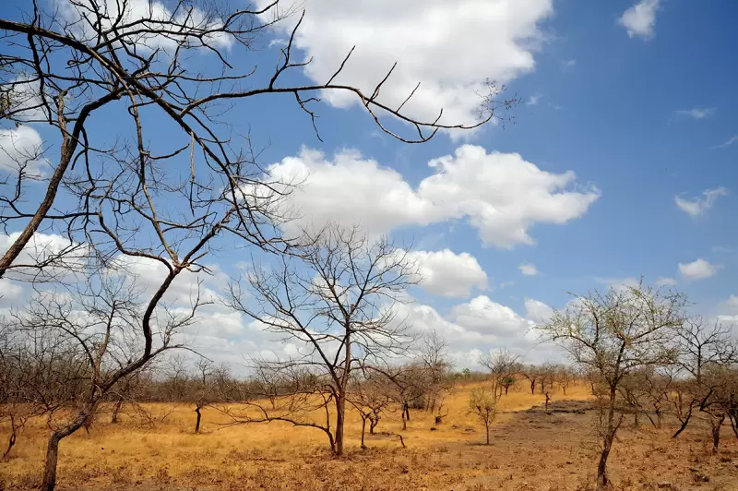
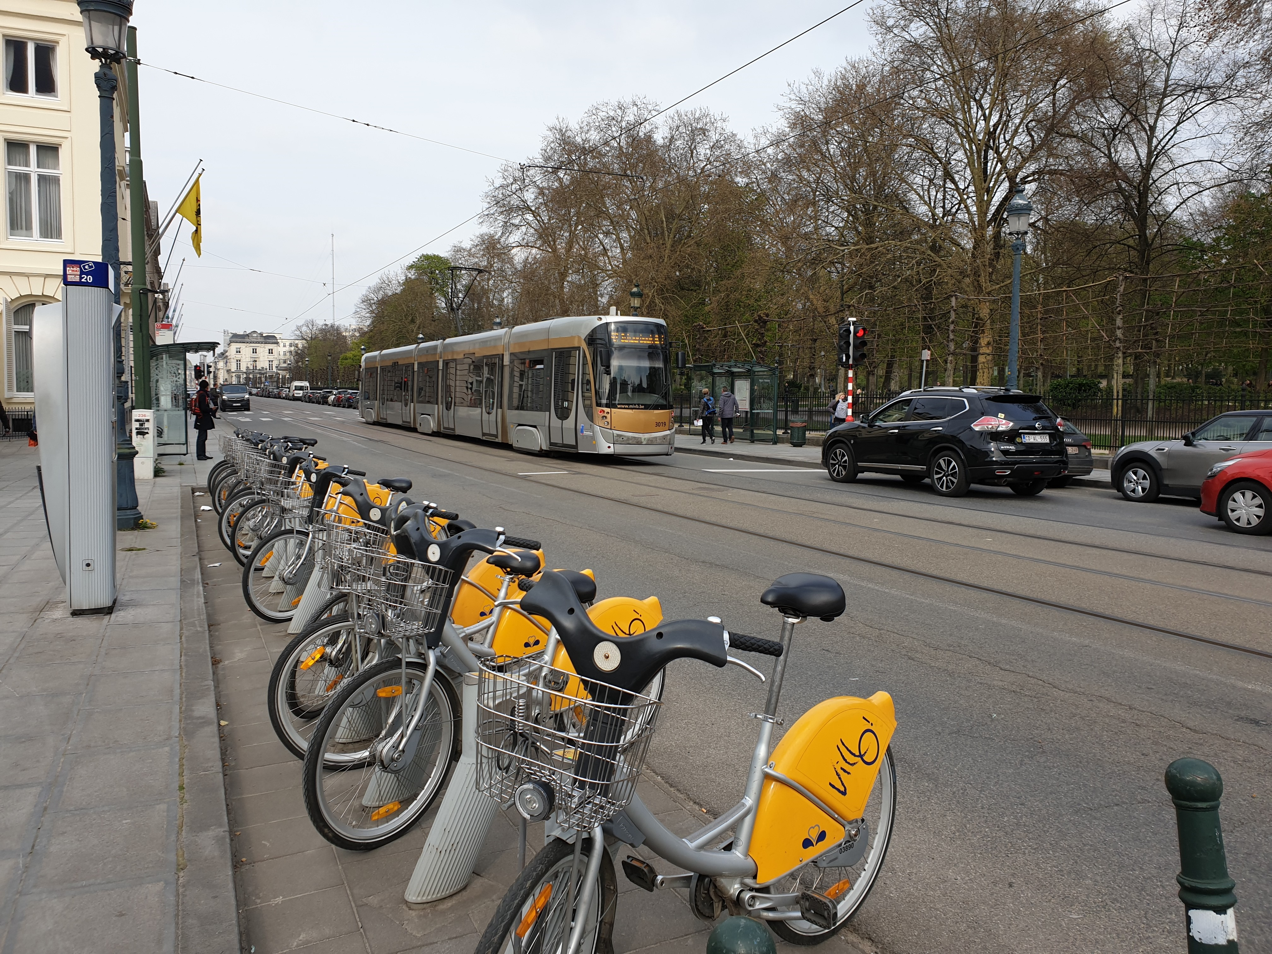
Opportunities for Climate Action using Islamic Financial Instruments
Capital Market (Islamic) financial Instruments for resilience climate adaptation finance offers untapped solutions aligned with Shariah principles and sustainability goals.
Indonesia: The first sovereign green Sukuk issued by a Muslim-majority country.
Funded reforestation, renewable energy, and flood management.
IsDB provided technical assistance and capacity building.
Blended Finance Approach with other co-fianciers using an Ijarah-based financing model
Morocco: Noor Solar Complex – Ouarzazate, IsDB co-financed one of the world’s largest solar power plants alongside another financier, such as the World Bank and the African Development Bank

Slide 9
Examples of Financial Resources we Have Leveraged for Member Countries
Mobilized approx. US$ 800k for Nigeria, Lebanon and Palestine under the Climate Action Enhancement Package (CAEP) to deliver targeted, fast-track support to countries to enhance the quality, increase the ambition, and implement the NDCs.
Over US$ 1.2 million for Pakistan from the NDC-P PAF window
Mobilized approx. US$ 2.7 million for Jordan, Lebanon, Iraq, Oman, and Palestine under the Green Climate Fund readiness program for private sector actors. Leveraging the Private Sector for Increased Climate Investment and Strengthened Partnerships in the West Asia Region
USD 2.3 million Government of Maldives for its readiness program in the financial sector and private sector
Over USD 4.3 billion from the Systematic Observations Financing Facility (SOFF), a UN Multi-Partner Trust Fund to support member countries through partner institutions. To support Uganda with early warning systems
Mobilise over USD 2 million for Yemen to help with the climate adaptation strategy through telemedicine in the country.

Slide 10
Thank You

