Slide 1



Strengthening the Resilience of Family Farmers and Small-scale Producers in the Agriculture and Food Sector in
OIC Member Countries
Case Study: Senegal
24th MEETING OF THE COMCEC AGRICULTURE WORKING GROUP
Haluk Gedikoğlu
Associate Professor
Konya Food and Agriculture University
April ${22}^{nd}$, 2025

Slide 2
Project Team
Haluk Gedikoglu
  Associate Professor, Agricultural Economist, Konya Food and Agriculture University
Sevim Seda Yamac
  Associate Professor, Agricultural Irrigation, Necmettin Erbakan University
Dilek Killi
  Assistant Profesor, Crop Science, Institute of Sustainable Plant Protection, Council of National Research-Italy
Mohammad Ansarian
  Ph.D. Student in Economics, Necmettin Erbakan University

Slide 3
Outline
Objective of the Study
Measuring Resilience in Senegal
Factors Influencing Resilience
  Results of the Regression Analysis
  Results of the Principal Component Analysis
Policy Recommendations
Conclusion

Slide 4
Objective
The objective of this study is to measure the resilience and identify the factors that influence the resilience of the family farms and small-scale producers in Senegal.
With the identified factors policy recommendations will be provided to strengthening the resilience of the family farmers and small-scale producers in Senegal.

Slide 5
Resilience
% Change in the Value of Agricultural Production = $\frac{y_{t}−y_{t−1}}{y_{t−1}}∗100$
$t:1960,..,2023$
% Change in the Value of Agricultural Production per Hectare = $\frac{v_{t}−v_{t−1}}{v_{t−1}}∗100$
Positive % Change -> Resilient
Zero % Change -> Resilient
Negative % Change -> Non-resilient

Slide 6
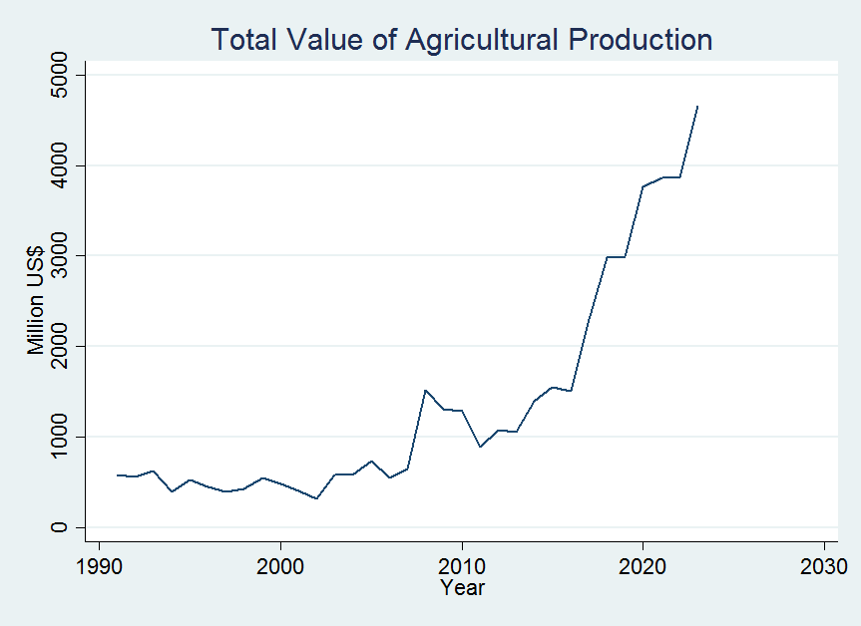
Resilience

Slide 7
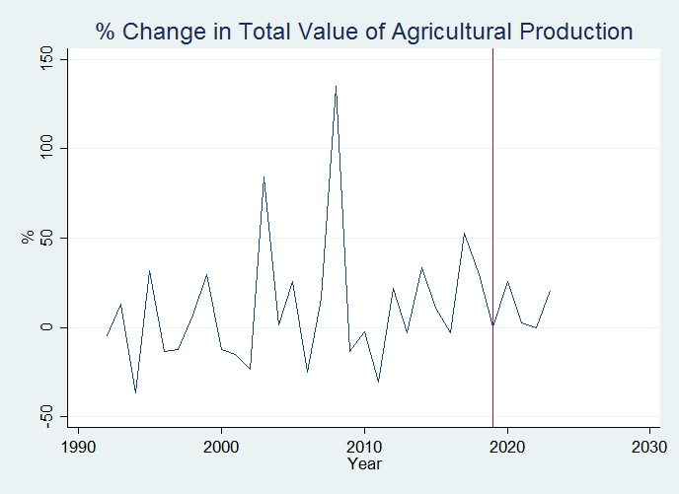
Resilience

Slide 8
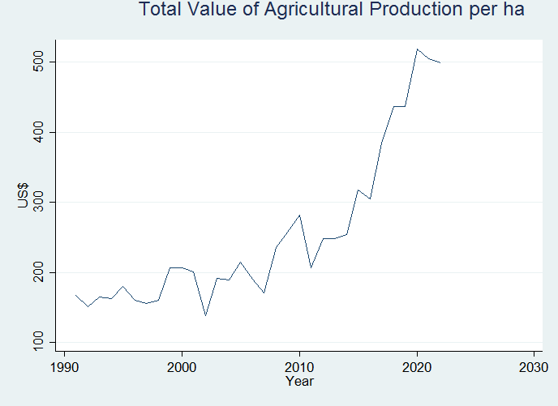
Resilience

Slide 9
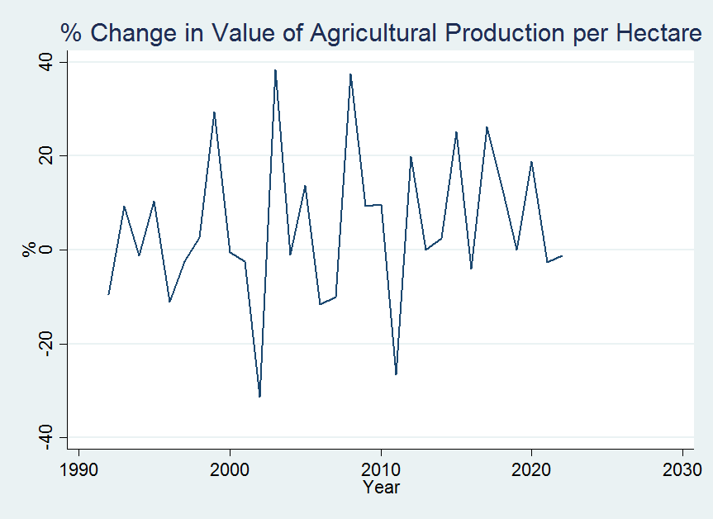
Resilience

Slide 10
Resilience
Resilience of agricultural production can show variation from one year to another.
Agricultural production system can be resilient in one year and non-resilient in the following year.
Hence, the resilience of the system should be checked regularly.
Alternative ways to measure resilience can lead to different results.
In Senegal, agricultural production shows less fluctuations after 2010 and the system looks more resilient.

Slide 11
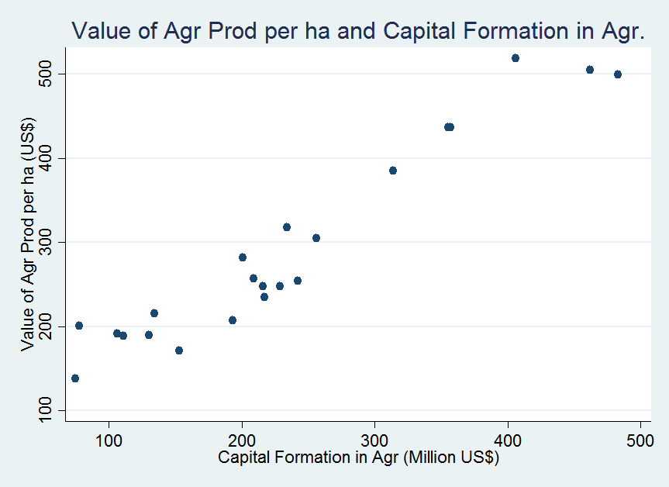
Factors Influencing Resilience:
Capital Formation

Slide 12
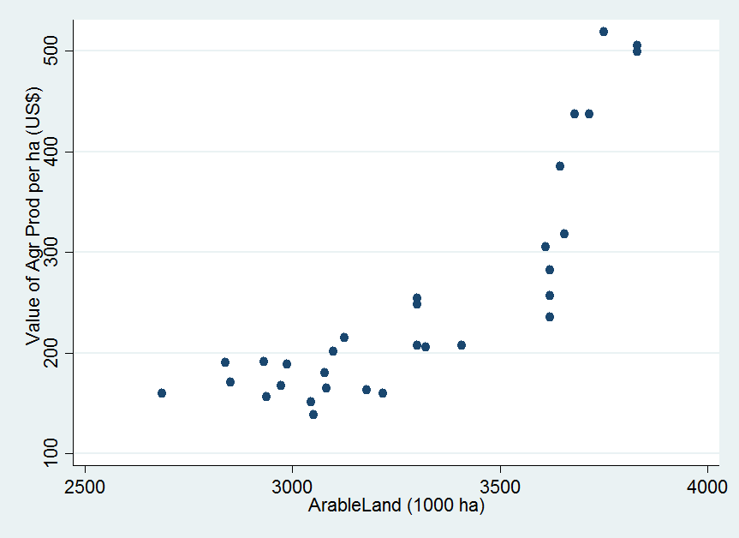
Factors Influencing Resilience:
Arable Land

Slide 13
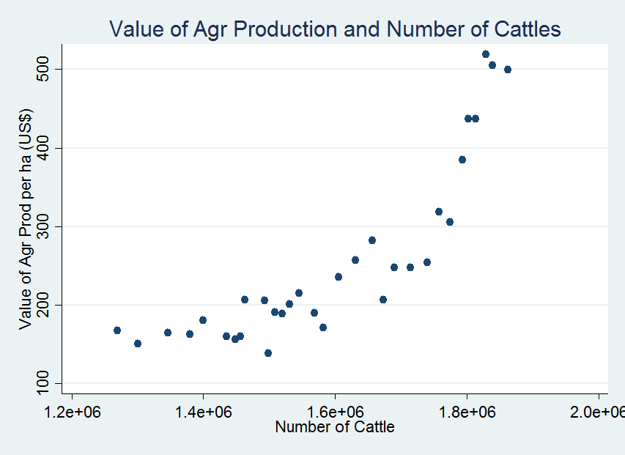
Factors Influencing Resilience:
Livestock Inventory

Slide 14
Regression Analysis
Dept. Variable: % Change in Value of Total Agricultural Production for Senegal
Variable | Coeff. | Std. Err. | t-Stat | p-Value
∆ Credit | - 0.090 | 0.137 | -0.66 | 0.522
∆ Capital | 1.424 | 0.296 | 8.17 | 0.000
∆ Cattle | 0.050 | 0.002 | 0.22 | 0.832
∆ ArableLand | 0.067 | 0.514 | 3.99 | 0.012
Constant | -0.045 | 0.057 | 0.44 | 0.442
N | 19
Adjusted R² | 0.745
F(4,14) | 36.87
p-Value | 0.000

Slide 15
Regression Analysis
Dept. Variable: % Change in Value of Agricultural Production per Hectare for Senegal
Variable | Coeff. | Std. Err. | t-Stat | p-Value
∆ Credit | - 0.003 | 0.002 | -1.15 | 0.271
∆ Capital | 0.004 | 0.002 | 2.11 | 0.053
∆ Cattle | 0.0001 | 0.0000 | 1.92 | 0.076
∆ ArableLand | 0.001 | 0.0002 | 1.98 | 0.068
Constant | -0.049 | 0.049 | -1.00 | 0.337
N | 19
Adjusted R² | 0.508
F(4,14) | 5.66
p-Value | 0.006

Slide 16
Regression Analysis
Results
  As the growth of capital accumulation in agriculture increases, the resilience increases.
  As the growth of access to arable land increases, the resilience increases.
  As the growth of number of cattle increases, the resilience increases (based on value per hectare).
Policy Implications
  Financial support programs, such as cost share programs, can be established for farmers to accumulate farm capital (e.g. building, equipment, machinery).
  Farmers access to arable land can be increased through government support programs, such as rent cost sharing, and long term rental contracts through leasing. Care should be taken for deforestation.
  Educational and financial support programs for livestock operators can be established to increase the number of cattle holdings.

Slide 17
Principal Component Analysis
Variable | Comp1 | Comp2
Credit | 0.470 | -0.254
Capital | 0.471 | -0.355
Cattle | 0.478 | -0.119
ArableLand | 0.439 | 0.042
FertilizerN | 0.366 | 0.890
Component | Eigenvalue | Proportion
Comp1 | 4.11 | 0.82
Comp2 | 0.54 | 0.11
N | 20

Slide 18
Regression Analysis &
Principal Component Analysis
Dept. Variable: % Change in Value of Total Agricultural Production
Variable | Coeff. | Std. Err. | t-Stat | p-Value
∆ PC1: Productive Assets | 0.573 | 0.139 | 4.10 | 0.001
∆ PC2: Variable Inputs | -0.279 | 0.086 | -3.24 | 0.005
Constant | -0.023 | 0.079 | -0.30 | 0.768
N | 19
Adjusted R² | 0.496
F(2,16) | 9.87
p-Value | 0.002

Slide 19
Regression Analysis &
Principal Component Analysis
Dept. Variable: % Change in Value of Agricultural Production per Hectare
Variable | Coeff. | Std. Err. | t-Stat | p-Value
∆ PC1: Productive Assets | 0.241 | 0.077 | 3.11 | 0.007
∆ PC2: Variable Inputs | -0.101 | 0.047 | -2.12 | 0.050
Constant | -0.014 | 0.044 | -0.32 | 0.750
N | 19
Adjusted R² | 0.322
F(2,16) | 5.27
p-Value | 0.017

Slide 20
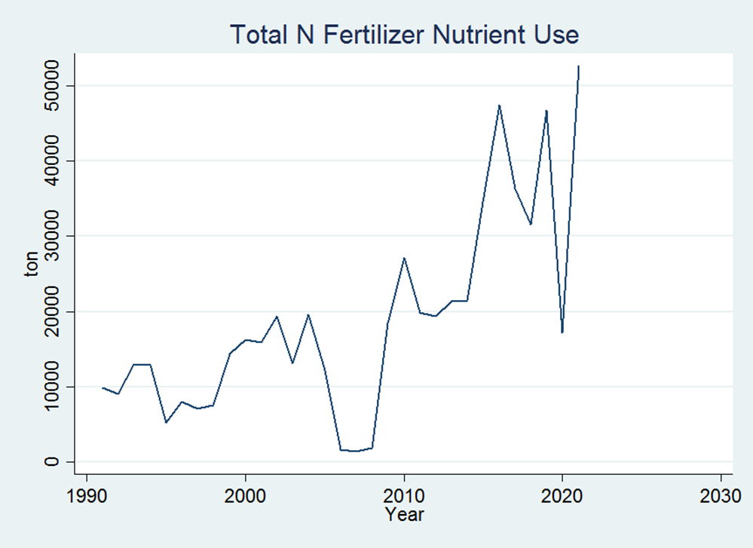
Regression Analysis &
Principal Component Analysis
Results
  As the growth of access to productive assets/inputs in agriculture increases, the resilience increases.
  As the growth of variable inputs (import dependent) increases, the resilience decreases.

Slide 21
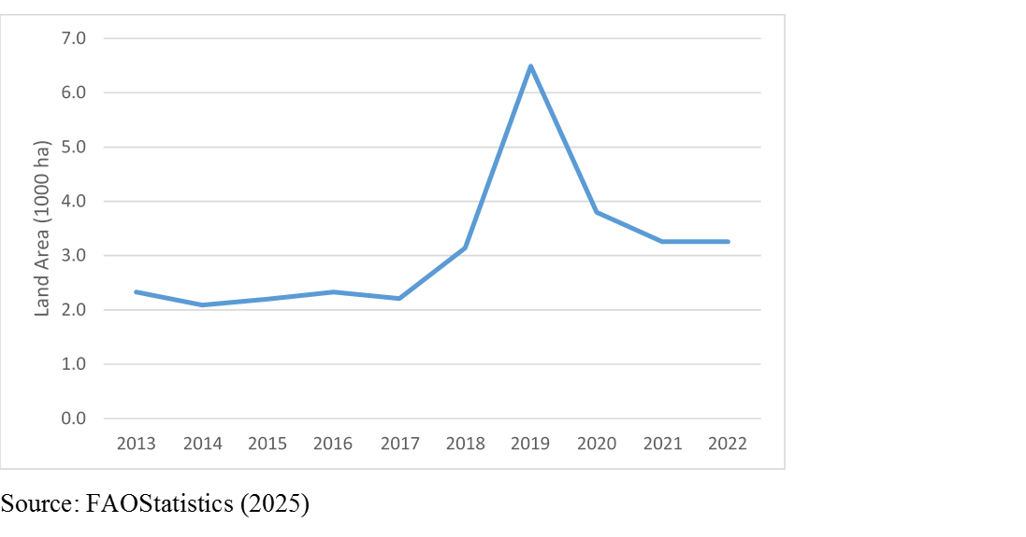
Regression Analysis &
Principal Component Analysis
Policy Implications
  Farmers reliance on especially import dependent variable input can be decreased through alternative production systems, such as organic farming and use of manure.
  Marketing support programs can be developed to connect farmers of organic agriculture to different market outlets, such as those in big cities and even to international markets.

Slide 22
Regression Analysis &
Principal Component Analysis
Forest land is critical both sustainable agriculture and income generated for the farmers as a productive asset.
A market based approach could be to educate public to generate market premium for crops produced without deforestation, which is currently in the European Union.

Slide 23
Conclusion
Agricultural production system can be resilient in one year and non-resilient in the following year.
The resilience of the system should be checked regularly.
Financial support programs, such as cost share programs, can be established for farmers to accumulate farm capital.
Farmers access to arable land can be increased through government support programs, such as rent cost sharing.
  Care should be taken for deforestation.
Educational and financial support programs can be established to increase the number of cattle holdings.
As the growth of variable inputs (import dependent) increases, the resilience decreases.
  Organic production can be supported through generating alternative marketing outlets.

Slide 24
Thank You!
24th MEETING OF THE COMCEC AGRICULTURE WORKING GROUP

