Slide 1
Strengthening the Resilience of Family Farmers and Small-scale Producers in the Agriculture and Food Sector in OIC Member Countries
24th MEETING OF THE COMCEC AGRICULTURE WORKING GROUP
Assoc. Prof. Haluk Gedikoğlu
Agricultural Economist
Konya Food and Agriculture University
April ${22}^{nd}$, 2025

Slide 2
Project Team
Haluk Gedikoglu
Associate Professor, Agricultural Economist, Konya Food and Agriculture University & University of Missouri
Sevim Seda Yamac
Associate Professor, Agricultural Irrigation, Necmettin Erbakan University
Dilek Killi
Assistant Profesor, Crop Science, Institute of Sustainable Plant Protection, Council of National Research-Italy
Mohammad Ansarian
Ph.D. Student in Economics, Necmettin Erbakan University

Slide 3
Outline
Objective of the Study
Defining and Measuring Resilience
Conceptual Framework and Methodology
Club Convergence
Regression Analysis
Principal Component Analysis
Data Collection
Policy Recommendations

Slide 4
Objective
The objective of this study is to measure the resilience and identify the factors that influence the resilience of the family farms and small-scale producers in the OIC member countries.
With the identified factors policy recommendations will be provided to strengthening the resilience of the family farmers and small-scale producers.

Slide 5
Resilience
Resilience is defined as the capacity of the farmers to continue to produce agricultural products in the face of negative external shocks.
We measure the continuation of agricultural production with total value of agricultural products produced and the value of agricultural production per hectare at the national level.
We specifically use the yearly percentage change of total value of agricultural production and the yearly percentage change of value of the agricultural production per hectare to see if the system is resilient.
Non-negative changes in the face of shocks imply resilience.

Slide 6
Resilience
% Change in the Value of Agricultural Production = $\frac{y_{t}−y_{t−1}}{y_{t−1}}∗100$
$t:1960,..,2023$
% Change in the Value of Agricultural Production per Hectare = $\frac{v_{t}−v_{t−1}}{v_{t−1}}∗100$
Positive % Change -> Resilient
Zero % Change -> Resilient
Negative % Change -> Non-resilient

Slide 7
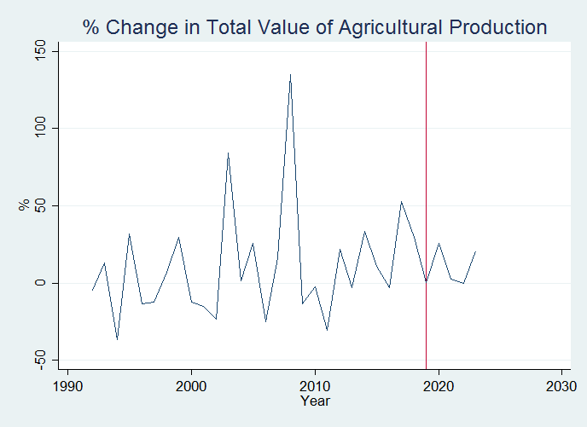
Resilience

Slide 8
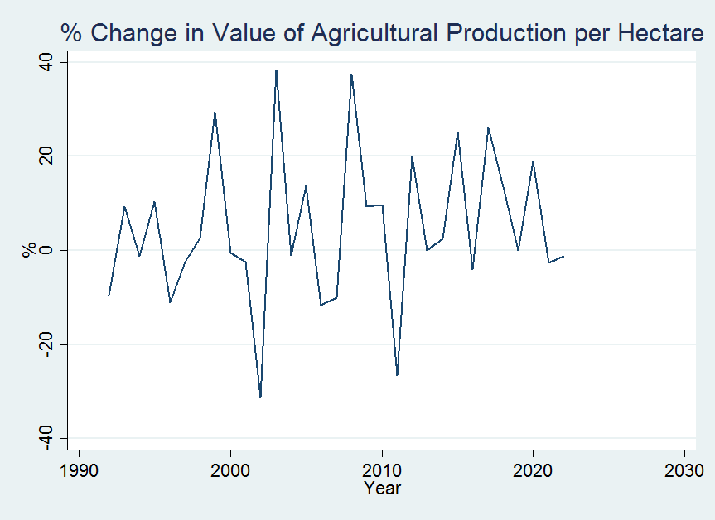
Resilience

Slide 9
Conceptual Framework and Methodology
Convergence Analysis and Club Convergence
We will be using club convergence to identify the sub-group of countries with similarities.
This will allow us to classify countries with higher level of resilience to lower level of resilience.
Regression Analysis
We will be using regression analysis to determine the factors that have influence on resilience of countries.
Principal Component Analysis
We will also use principal component analysis for the highly correlated factors to determine those that have high influence on the resilience capacity of a country.
We will also look at the sub-groups of these factors.

Slide 10
Regression Analysis
Dept. Variable: % Change in Value of Total Agricultural Production
Variable | Coeff. | Std. Err. | t-Stat | p-Value
∆ Credit | - 0.090 | 0.137 | -0.66 | 0.522
∆ Capital | 1.424 | 0.296 | 8.17 | 0.000
∆ Cattle | 0.050 | 0.002 | 0.22 | 0.832
∆ ArableLand | 0.067 | 0.514 | 3.99 | 0.012
Constant | -0.045 | 0.057 | 0.44 | 0.442
N | 19
Adjusted R² | 0.745
F(4,14) | 36.87
p-Value | 0.000

Slide 11
Regression Analysis
Preliminary Results
As the growth of capital accumulation in agriculture increases, the resilience increases.
As the growth of access to arable land increases, the resilience increases.
Policy Implications
Financial support programs, such as cost share programs, can be established for farmers to accumulate farm capital (e.g. building, equipment, machinery).
Farmers access to arable land can be increased through government support programs, such as rent cost sharing, and long term rental contracts through leasing.

Slide 12
Principal Component Analysis
Variable | Comp1 | Comp2
Credit | 0.470 | -0.254
Capital | 0.471 | -0.355
Cattle | 0.478 | -0.119
ArableLand | 0.439 | 0.042
FertilizerN | 0.366 | 0.890
Component | Eigenvalue | Proportion
Comp1 | 4.11 | 0.82
Comp2 | 0.54 | 0.11
N | 20

Slide 13
Regression Analysis & Principal Component Analysis
Dept. Variable: % Change in Value of Total Agricultural Production
Variable | Coeff. | Std. Err. | t-Stat | p-Value
∆ PC1: Productive Assest | 0.241 | 0.077 | 3.11 | 0.007
∆ PC2: Variable Inputs | -0.101 | 0.047 | -2.12 | 0.050
Constant | -0.014 | 0.044 | -0.32 | 0.442
N | 19
Adjusted R² | 0.322
F(2,16) | 5.27
p-Value | 0.017

Slide 14
Regression Analysis
Preliminary Results
As the growth of access to productive assets/inputs in agriculture increases, the resilience increases.
As the growth of variable inputs (import dependent) increases, the resilience decreases.
Policy Implications
Financial support programs, such as cost share programs, can be established for farmers to access productive assets / inputs (e.g. building, equipment, machinery).
Farmers reliance on especially import dependent variable input can be decreased through alternative production systems, such as organic farming.
Use of manure instead of import dependent fertilizer can be encouraged through financial support programs.

Slide 15
Data Collection
Resilience Analysis in OIC Member Countries Based on the International Databases and the Review of the Literature
FAO Statistics, World Bank Statistics, SESRIC, OECD
Measurement of Resilience
% Change in Market Value of Agricultural Production and Value per Hectare
Factors Influencing the Resilience Capacity
Access to Credit and Productive Assets
Access to Technology
Demographic Factors and Adaptive Capacity

Slide 16
Data Collection
Survey
An agricultural household survey will be constructed to identify the factors those influence
limited access to markets,
technology,
financial resources
identify the resilience of the family farmers and small scale producers in the OIC Member Countries.
When conducting the inferential statistics and data analysis, OIC member countries will be grouped according to their resilience of family farmers and small-scale producers.
The survey will be designed based on the literature review conducted (Dillman, 2000).
The survey will be conducted through face-to-face interviews, phone interviews, and online-interviews with the identified authorities.

Slide 17
Data Collection
Field Visit Case Studies
Field visits to one African group and one Asian group countries will be conducted to conduct an in-depth analysis of the history and current situation of resilience of family farmers and small-scale producers.
A detailed face-to-face interviews, using the survey prepared, will be conducted with the family-farmers, small-scale producers, and public and private sector representatives.
At the end of each visit, an assessment of the resilience of family farmers and small-scale producers will be conducted and applicable policy recommendations will be developed.
These policy recommendations will be specific and target oriented, and will address the problem areas and barriers to the resilience of family farmers and small-scale producers.

Slide 18
Data Collection
Desk-Based Case Studies
An analysis of a minimum of one non-OIC (e.g. Unites States) and two OIC Countries (e.g. Senegal and Türkiye) as case studies, based on desk research, will be conducted.
These case studies will address the resilience of family farmers and small-scale producers and cover the topics included in the survey designed.
Overall, linkages will be formed between field-visits and desk-based studies to better form resilience of the family farmers and small-scale producers.

Slide 19
Policy Recommendations
Financial support programs, such as cost share programs, can be established for farmers to accumulate farm capital (e.g. building, equipment, machinery).
Farmers access to arable land can be increased through government support programs, such as rent cost sharing, and long term rental contracts through leasing.
Farmers reliance on especially import dependent variable input can be decreased through alternative production systems, such as organic farming.
Use of manure instead of import dependent fertilizer can be encouraged through financial support programs.

Slide 20
Thank You!
24th MEETING OF THE COMCEC AGRICULTURE WORKING GROUP

